Slide 1


Fleet Analytics • Reliability Engineering • Digital Mine Technologies
Performance Monitoring & Improvement Opportunities
in OB & Coal Operations
through FMS & FUMS Data
SUMMER INTERNSHIP REPORT · TALABIRA II & III OPEN CAST PROJECT
PRESENTED BY
INDUSTRY MENTOR
Sushant Rathore
Nabal Kishor Sharma
B.Tech, Mining Engineering (ME'27)
IIT (ISM) Dhanbad
Adani Natural Resources | Talabira II & III Open Cast Project | 2026

Slide 2

Presenter Profile
INTRODUCTION
INTERNSHIP
Sushant Rathore
Adani Natural Resources
Final-year Mining Engineering student with a strong focus on operational data analytics, fleet performance and asset optimization in surface mining.
Talabira II & III Open Cast Project
Summer Internship • (2026)
EDUCATION
TECHNICAL INTERESTS
B.Tech, Mining Engineering (ME'27)
Mining Operations & Fleet Performance Analytics
Indian Institute of Technology (ISM), Dhanbad
Reliability Engineering & Asset Management
Digital Mining Technologies

Slide 3
Business Context
MINE SNAPSHOT
Talabira II & III OCP
20 MTPA
199 HEMM
Mine Operations Dept.
Adani Natural Resources (MDO)
Normative Capacity
GPS-Enabled Fleet
FMS & FUMS Monitored
DIGITAL MONITORING INFRASTRUCTURE
Fleet Management System (FMS)
Fuel Management System (FUMS)
Real-time monitoring of fleet operations using GPS and telematics.
Automated monitoring and management of fuel dispensing.
Equipment Tracking • Trip Monitoring • Production Monitoring • Equipment Utilization
Fuel Dispensing • Fuel Consumption • Fuel Inventory • Fuel Efficiency
Operational Capabilities
Real-Time Fleet Visibility
Production Monitoring
Fuel Management
Equipment Utilization
Decision Support
Real-time view of equipment location and status.
Continuous tracking of output against targets.
Oversight of consumption and dispensing patterns.
Insight into how effectively assets are used.
Data to guide faster operational choices.
PROJECT RATIONALE
Talabira's FMS and FUMS generate comprehensive operational data across production, fleet operations, and fuel management. While these systems effectively support routine monitoring, their analytical potential offers opportunities for deeper analysis. This project systematically analyses the available data to identify improvement opportunities and propose practical recommendations for enhancing productivity, equipment reliability, and operational decision-making across the mine.

Slide 4
Project Objectives
PROJECT AIM
To systematically evaluate operational performance at Talabira II & III OCP using FMS and FUMS data, identify improvement opportunities, and develop practical recommendations that enhance productivity, reliability, and operational efficiency.
PROJECT OBJECTIVES
01
02
03
04
Evaluate Fleet Performance
Analyse Production & Fuel Trends
Identify Improvement Opportunities
Recommend Practical Solutions
Assess availability, utilization, and reliability across the HEMM fleet.
Examine FMS and FUMS data to identify patterns in output and fuel consumption.
Pinpoint gaps in current monitoring and operational practices.
Propose data-backed actions to strengthen fleet and production outcomes.
Deliverables
Comprehensive Performance Assessment
Operational Improvement Opportunities
Data-Driven Recommendations
Enhanced Decision Support
A clear picture of current fleet and production performance.
Specific, evidence-based areas for operational gains.
Actionable proposals grounded in FMS/FUMS analysis.
A stronger basis for day-to-day operational decisions.

Slide 5
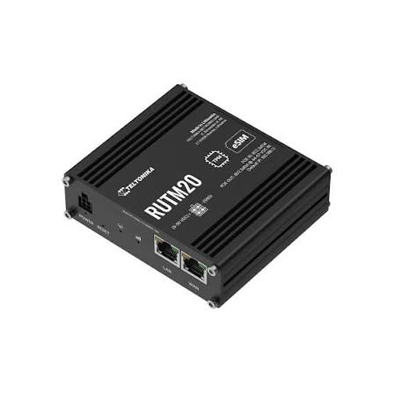
Current Operational Workflow
OPERATIONAL DATA FLOW
ROM Coal
(Weighbridge Report)
Fuel Consumption
(Fuel Report)
GPS Position/Speed
GPS Satellites
(GNSS Constellation)
Vehicle Tracking Unit
Cellular Transmission
Central FMS Server
(Data Processing + Analytical)
Dashboard & MIS Reports
Ignition
(Wire Sense)
HMR
(Hour Meter Wire)
Operational data is processed into production and performance insights for operational decision-making.
CURRENT SYSTEM CAPABILITIES
Fleet Visibility
Production Monitoring
Fuel Management
Performance Reporting
Real-time equipment tracking
OB & ROM production tracking
RFID-based fuel monitoring
Availability, utilization & MIS reporting
KEY FOCUS AREAS
Production Accuracy
Machine Diagnostics
Equipment Health Monitoring
Operational Decision Support
Static Truck Factor estimation
No integrated machine diagnostics
Limited access to machine health data
Limited real-time operational insights

Slide 6
Project Approach & Methodology
EXECUTION TIMELINE
PHASE 1
PHASE 3
PHASE 5
System
Familiarization
Data
Acquisition
Opportunity
Identification
PHASE 2
PHASE 4
PHASE 6
Stakeholder
Consultation
Performance
Analysis
Recommendation
Development
STAKEHOLDER ENGAGEMENT
PRIMARY DATA SOURCES (March – June ‘26)
Mine Operations Team
FMS Operations Team
Fleet Operations Data
Fuel Consumption Data
Survey Department
Project Mentor
Survey & Production Records
Equipment Performance Data

Slide 7
Fleet Performance Assessment
SUPPORTING PERFORMANCE TRENDS
Equipment Availability
Fleet Utilization
↓ 9.6 percentage point decline during the study period
Lowest utilization recorded in April with partial recovery in May
BREAKDOWN PERFORMANCE
Fleet Breakdown Hours
OPERATIONAL HIGHLIGHTS
NON-OPERATIONAL FLEET
BREAKDOWN HOURS
FLEET PERFORMANCE
7 → 9 → 14
49.9k → 64.3k
Availability ↓ Utilization ↓
Machines remained non-operational
≈29% increase over the study period
Overall fleet performance declined

Slide 8
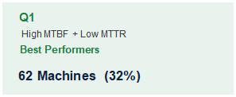
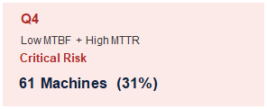
Fleet Reliability Assessment
MTBF-MTTR RELIABILITY CLASSIFICATION
Fleet Median: MTBF = 110 hrs | MTTR = 48.2 hrs (193 machines)
↑ High
MTBF
Q2
Q1 — Protect & Benchmark
High MTBF + High MTTR
Replicate maintenance best practices across similar assets.
Reliable, Slow Repair
36 Machines (18%)
Q2 — Reduce Repair Time
Improve spare availability and workshop turnaround.
↓ Low
MTBF
Q3
Q3 — Root Cause Analysis
Low MTBF + Low MTTR
Eliminate recurring failures through preventive maintenance redesign.
Frequent but Fast
34 Machines (18%)
Q4 — Immediate Intervention
Prioritize repairs, fast-track spare procurement and evaluate fleet renewal.
← Low MTTR High MTTR →
IS BREAKDOWN CONCENTRATED? — PARETO ANALYSIS
CRITICAL FLEET
Top 15 Machines
18.0%
61 Machines
Top 40 Machines
40.8%
Highest maintenance priority for Q4
Machines contributing 80% BD
56.0%
Remaining Machines
20.0%
PARETO FINDING
56% Fleet → 80% BD Hrs
KEY RELIABILITY INSIGHT
Broad-based reliability issue
56% of the fleet contributes to 80% of total breakdown hours, indicating a fleet-wide reliability issue rather than a classical 80/20 concentration.

Slide 9
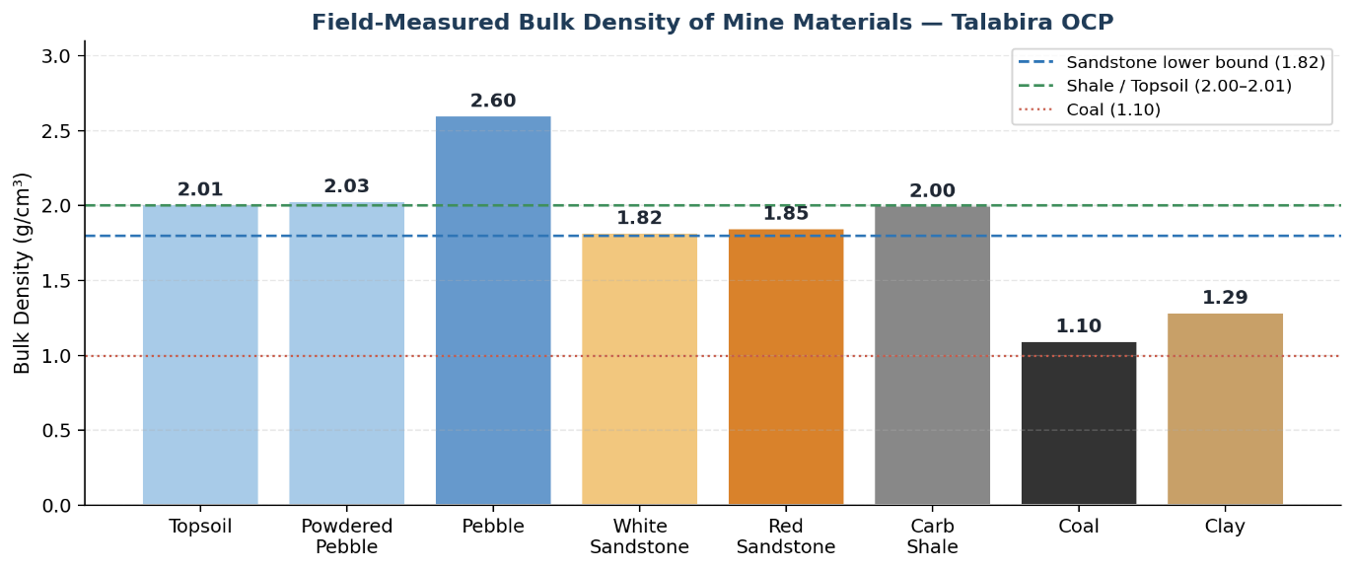
Production Validation Studies
Bulk Density Assessment
Field measurement of representative mine materials
Engineering Insight
Measured bulk densities varied from 1.10 to 2.60 g/cm³ across mine materials. This significant variation demonstrates that a single static Truck Factor cannot accurately represent all overburden materials, resulting in potential production estimation errors. The findings support the need for material-specific or Dynamic Truck Factors.
Dumper Cycle Time Validation
Survey Reconciliation
Field validation of FMS cycle time recording — Komatsu HD785 Dumper
Comparison of FMS-estimated and survey-measured overburden quantity (May 2026)
Field Observation
FMS Record
Survey Measurement
FMS Estimate
19 min 08 sec
FMS Validated
19 min 05 sec
1,616,656 m³
Production Deviation: 87,849 m³ (5.43%)
1,528,807 m³
Reconciliation Finding Independent survey measurements recorded 5.43% higher overburden quantity than the FMS estimate. The deviation is primarily attributed to the use of a single static Truck Factor despite varying material densities.
Validation Finding Manual stopwatch observations differed by only 3 seconds from the FMS record, confirming the accuracy and reliability of FMS cycle time tracking.

Slide 10
Operational Improvement Initiatives
Q4 Machine Recovery Programme
Failure Code Framework
30-Day Mandatory Resolution
Maintenance Analytics Enhancement
KEY FINDING
KEY FINDING
61 machines remained in the critical (Q4) reliability quadrant.
Breakdown hours are recorded without standardized failure-mode classification.
KEY ACTIONS
KEY ACTIONS
Machine Classification
Ownership Assignment
Weekly Monitoring
Standardized Failure Codes
Monthly Analytics Dashboard
Root Cause Analysis
SUCCESS TARGET
SUCCESS TARGET
61 → <45 Q4 Machines within 90 Days
Component-Level Diagnostics & PM Optimization
HMR-Based Preventive Maintenance
V-Series Fleet Renewal
Ring-Fenced Preventive Maintenance Crew
Fleet Economic Decision
KEY FINDING
KEY FINDING
Preventive maintenance is not consistently scheduled using Hour Meter Reading.
Ageing V-series tippers exhibit persistent failures and prolonged downtime.
KEY ACTIONS
KEY ACTIONS
Auto HMR Alerts
Dedicated PM Crew
Compliance Monitoring
Life Cycle Cost Analysis
Fleet Prioritization
Phased Replacement
SUCCESS TARGET
SUCCESS TARGET
Reduced Reactive Maintenance & Higher PM Compliance
Improved Fleet Reliability & Lower Lifecycle Cost

Slide 11
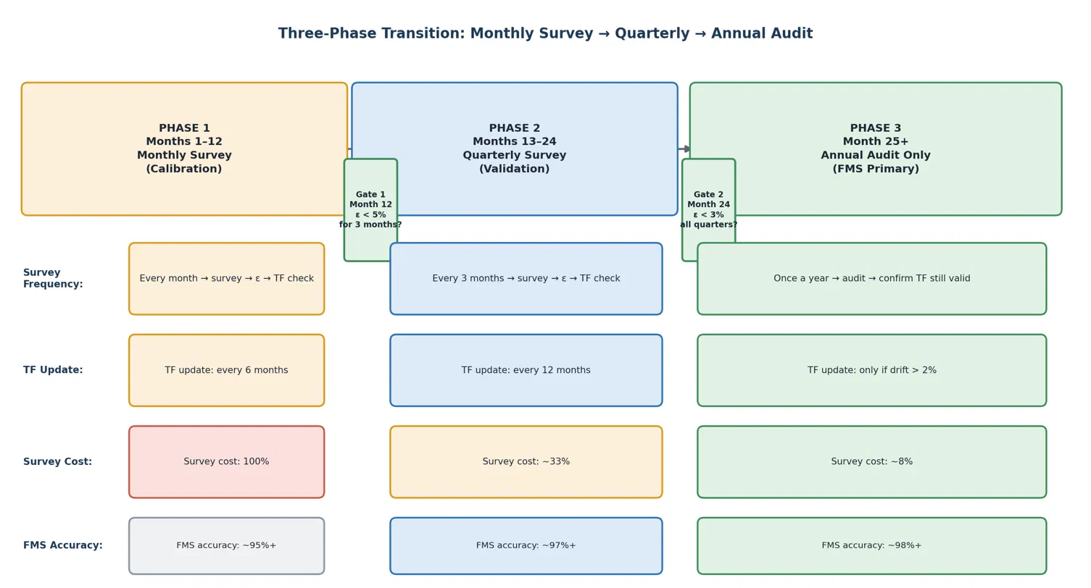
Engineering Solution Frameworks
DYNAMIC TRUCK FACTOR IMPLEMENTATION ROADMAP
Progressive implementation strategy for replacing static OEM Truck Factors with survey-calibrated Dynamic Truck Factors.
Engineering Outcome: Enables progressive reduction in survey frequency while maintaining high FMS production accuracy through Dynamic Truck Factor calibration.
CAN BUS INTEGRATION FRAMEWORK
Machine health monitoring architecture for predictive maintenance and advanced fleet analytics.
Machine
Sensors
→
ECUs
→
CAN Bus
Network
→
Telematics
Gateway
→
Cellular /
Satellite Link
→
FMS Analytics
Dashboard
Temperature, Pressure, RPM, Fuel Flow, Voltage
Signal acquisition, diagnostics and fault detection
Communication backbone
CAN aggregation and data transmission
Remote communication with offline buffering
Real-time monitoring, alerts and predictive analytics
PHASED DEPLOYMENT STRATEGY
Preparation
→
Pilot
→
Alert
Activation
→
Q4
Expansion
→
Fleet
Rollout
→
Continuous
Improvement
Engineering Outcome: Unlocks real-time machine health intelligence, enabling predictive maintenance and data-driven fleet reliability improvement.

Slide 12
Dynamic Truck Factor — Mathematical Derivation
Engineering derivation of the Dynamic Truck Factor using periodic survey reconciliation.
DEVIATION FACTOR (ε)
ε > 0 → FMS Underestimation → Increase TF
ε < 0 → FMS Overestimation → Reduce TF
ε = (VSurvey − VFMS) / VFMS
MATHEMATICAL DERIVATION
VActual = VFMS (1 + ε)
↓
VFMS = TFStatic × NTrips
↓
VActual = TFStatic × NTrips (1 + ε)
↓
Divide both sides by N Trips
↓
TFDynamic = TFStatic (1 + ε)
WORKED EXAMPLE (MAY 2026)
STEP 1 — DEVIATION CALCULATION
→
STEP 2 — MEDIUM DUMPER
→
STEP 3 — BIG DUMPER
ε = (1,616,656 − 1,528,807) / 1,528,807 = 5.75%
TF Dynamic = 26 × (1 + 0.0575) = 27.5 ≈ 27
TF Dynamic = 42 × (1 + 0.0575) = 44.4 ≈ 44
Truck Class
OEM TF
Dynamic TF
Small
13
14
Medium
26
27
Big
42
44

Slide 13
Business Impact & Expected Benefits
Operational improvements enabled through the proposed recommendations and engineering frameworks.
Production Accuracy
Maintenance Strategy
CURRENT STATE
CURRENT STATE
Static Truck Factor
Reactive Maintenance
↓
↓
FUTURE STATE
FUTURE STATE
Dynamic Truck Factor
Failure Code + HMR-Based PM
BUSINESS BENEFITS
BUSINESS BENEFITS
Higher Accuracy
Reduced Survey Cost
Improved Planning
Reduced Breakdowns
Higher Availability
Better PM Compliance
Fleet Visibility
Decision Support
CURRENT STATE
CURRENT STATE
Limited Machine Visibility
Fragmented Operational Data
↓
↓
FUTURE STATE
FUTURE STATE
CAN Bus Integration
Integrated Decision Support
BUSINESS BENEFITS
BUSINESS BENEFITS
Real-Time Monitoring
Early Fault Detection
Faster Decisions
Data-Driven Decisions
Resource Optimization
Higher Efficiency
OVERALL BUSINESS IMPACT
Together, the proposed operational improvements and engineering frameworks establish a scalable pathway toward safer, more reliable and data-driven fleet operations.

Slide 14
Towards a Digital Mine
Future technology integration for the next generation Fleet Management System.
Load Management System (LMS)
AI-Based Predictive Maintenance
CURRENT LIMITATION
CURRENT LIMITATION
Static Truck Factors estimate production but cannot measure payload on individual trips.
Maintenance is primarily reactive after faults become visible or failures occur.
FUTURE INTEGRATION
FUTURE INTEGRATION
Integrate suspension pressure/load sensors with CAN Bus to capture real-time trip-level payload within the existing FMS.
Apply AI/ML models to continuously analyse CAN Bus machine health parameters and identify developing failures before breakdown.
FUTURE VALUE
FUTURE VALUE
Real-time payload measurement for highly accurate production reporting.
Predict equipment failures using CAN Bus health data before breakdown occurs.
DIGITAL MINE VISION
Building upon the proposed Dynamic Truck Factor and CAN Bus frameworks, these technologies represent the next step toward a predictive, data-driven Digital Mine at Talabira II & III.

Slide 15
Key Learnings & Reflections
KEY LEARNINGS
Digital Mine Systems
Operational Analytics
Engineering Solutions
Industry Exposure
FMS • FUMS • Telematics • TLS
KPI Evaluation • Reliability Analysis
Framework Design • Process Improvement
Production • Survey • Fleet operations
CHALLENGES & MITIGATION
Data Quality & Consistency
Large–Scale Fleet Data
Operational Complexity
Implementation Constraints
Validation & Cross-checks
Structured Analysis
Cross-functional Collaboration
Scalable Engineering Solutions
The internship strengthened my ability to transform operational data into practical engineering solutions through structured analysis, field validation, and cross-functional collaboration.

Slide 16
Industrial Exposure at Talabira II & III OCP
Practical exposure across major opencast mining operations during the internship.
Mine Operations
Drilling & Blasting
Loading & Hauling
Production cycle from drilling to overburden and coal extraction.
Blast design, charging practices and fragmentation assessment.
Excavator–dumper deployment, haul road operations and fleet productivity.
HEMM Maintenance
Survey & Drone Mapping
Geology & Grade Control
Workshop practices, preventive maintenance and equipment inspection.
Drone survey, volumetric reconciliation and pit measurements.
Lithology identification, seam exposure and quality monitoring.
Explosives Management
Dispatch & Weighbridge
Mine Safety
Explosive magazine, detonators and statutory handling procedures.
Fleet dispatch, weighbridge operations and production reconciliation.
Safety committee meetings, field inspections and statutory safety practices.
OVERALL EXPOSURE
Developed a comprehensive understanding of end-to-end opencast mining operations through field exposures, cross-functional interaction and operational observation.

Slide 17
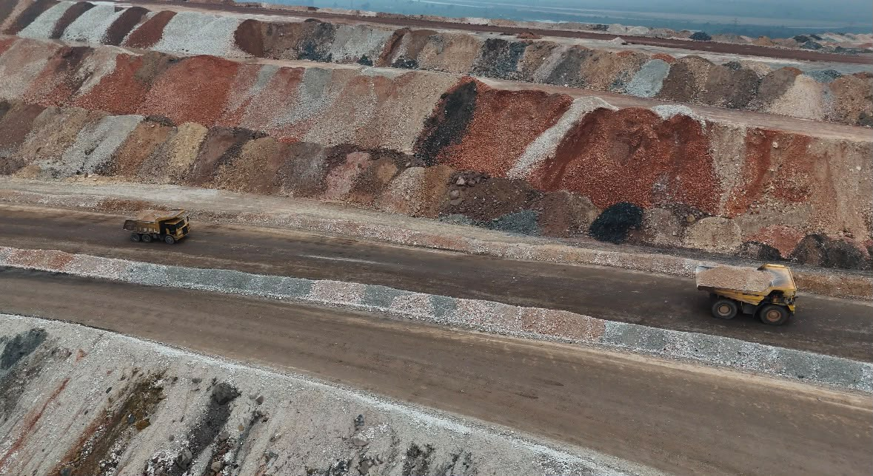
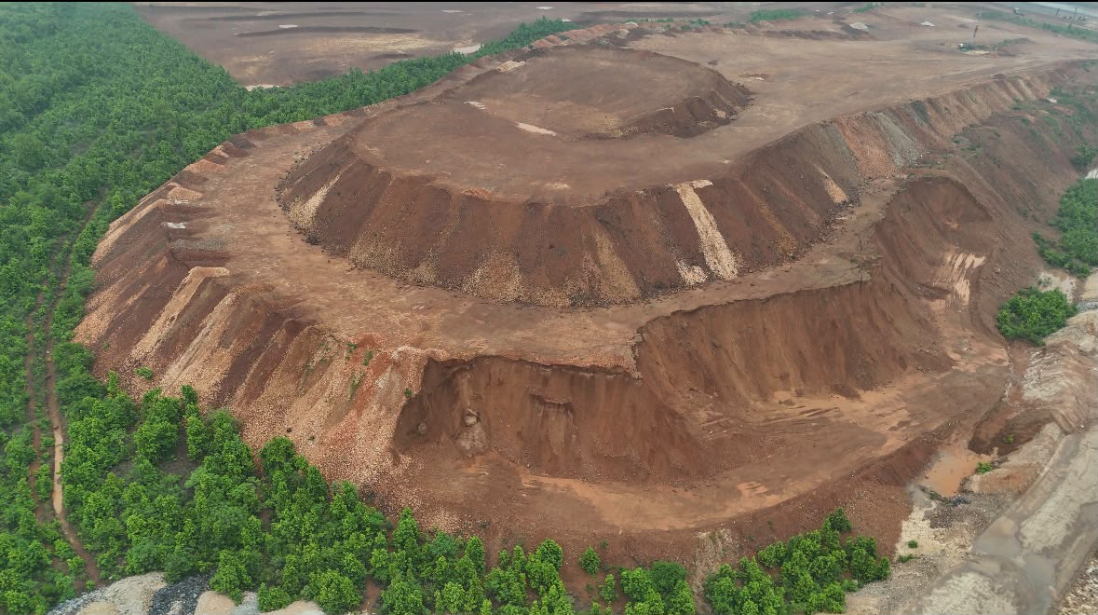
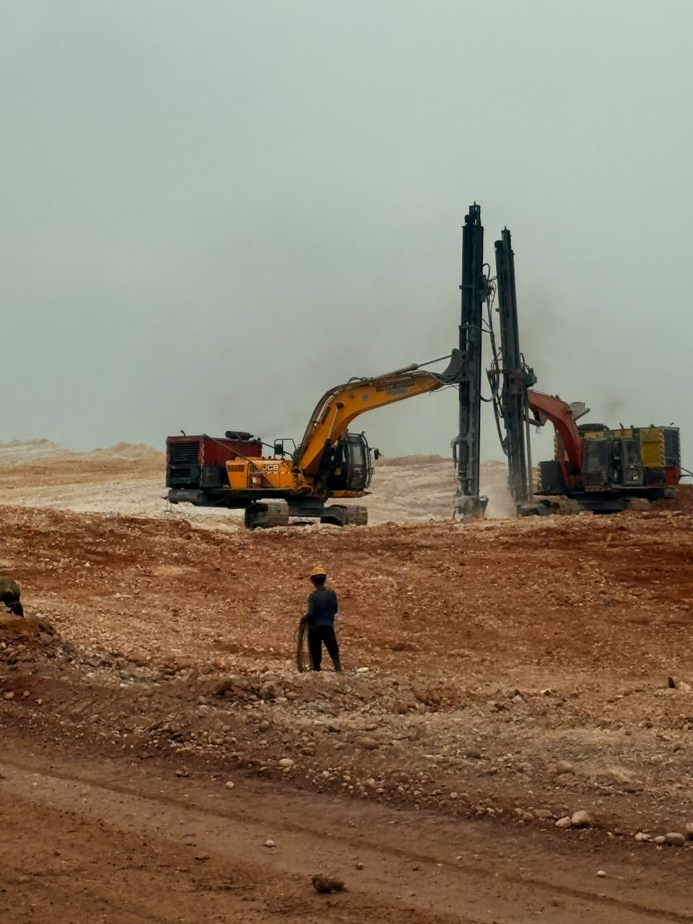
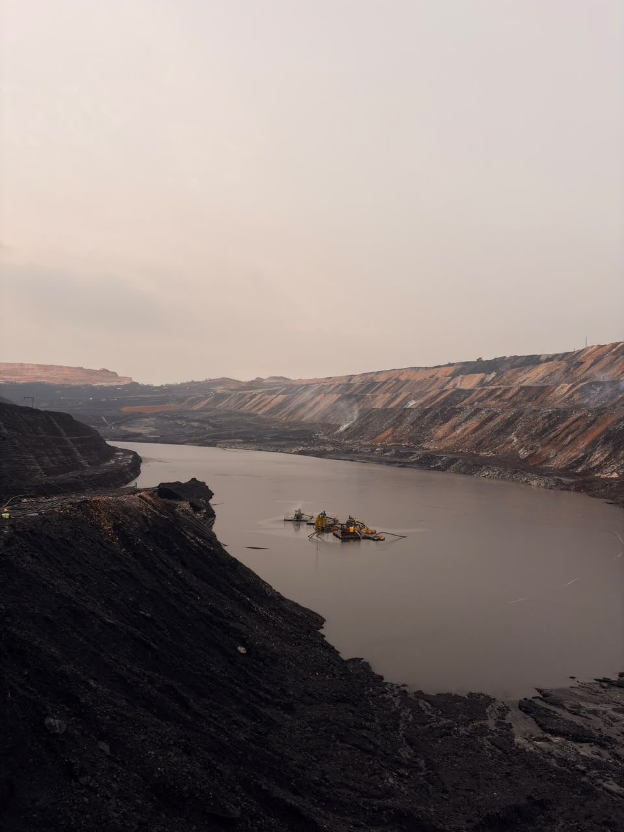
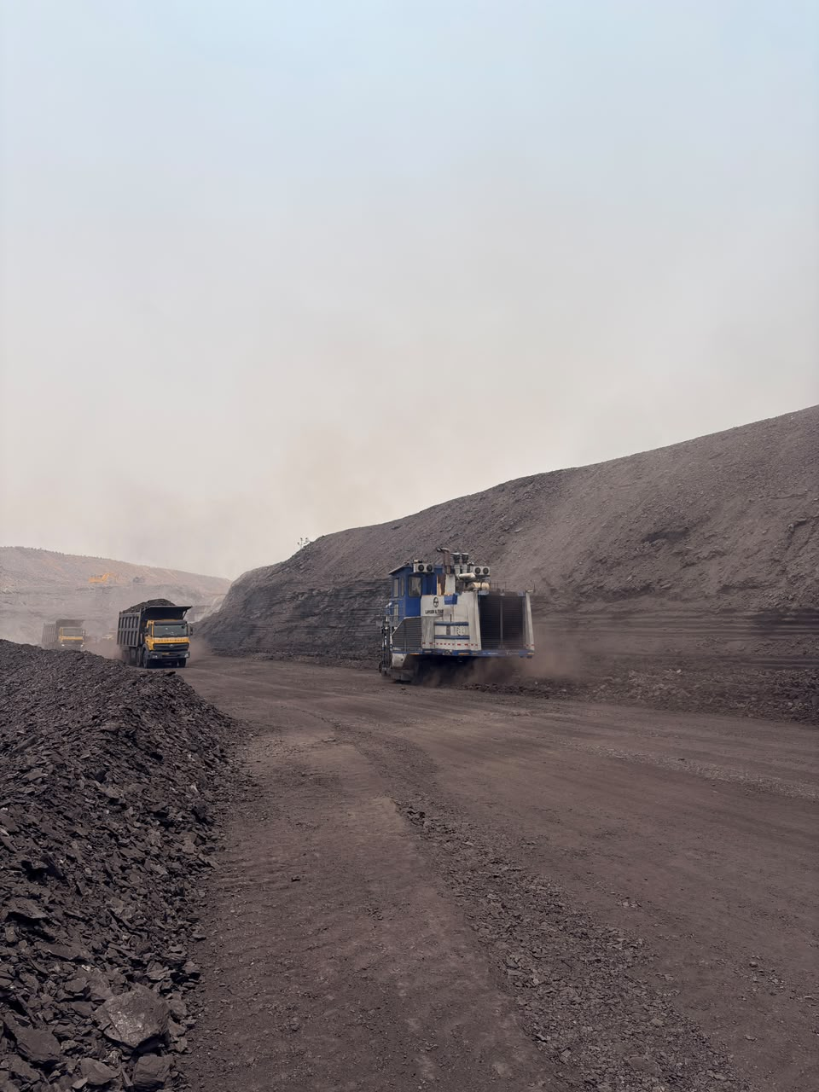
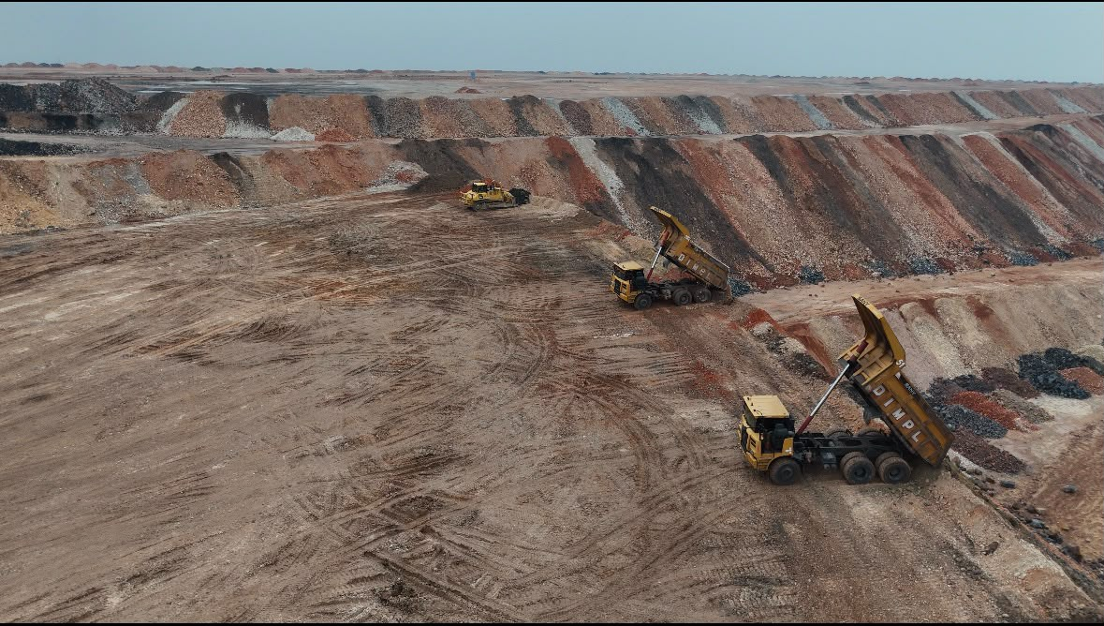
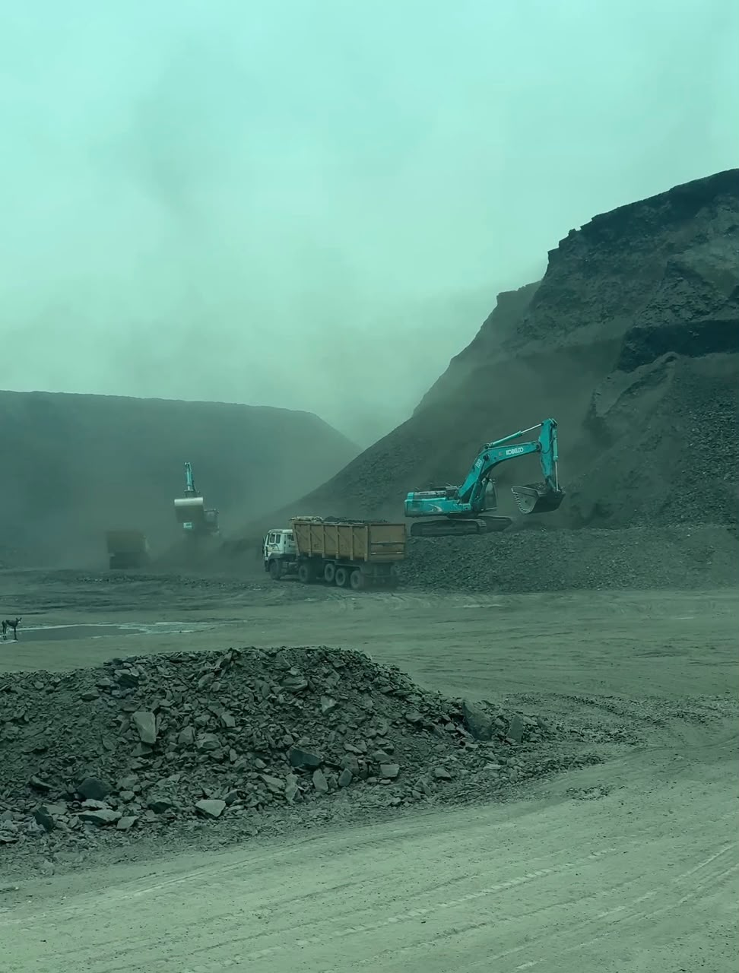
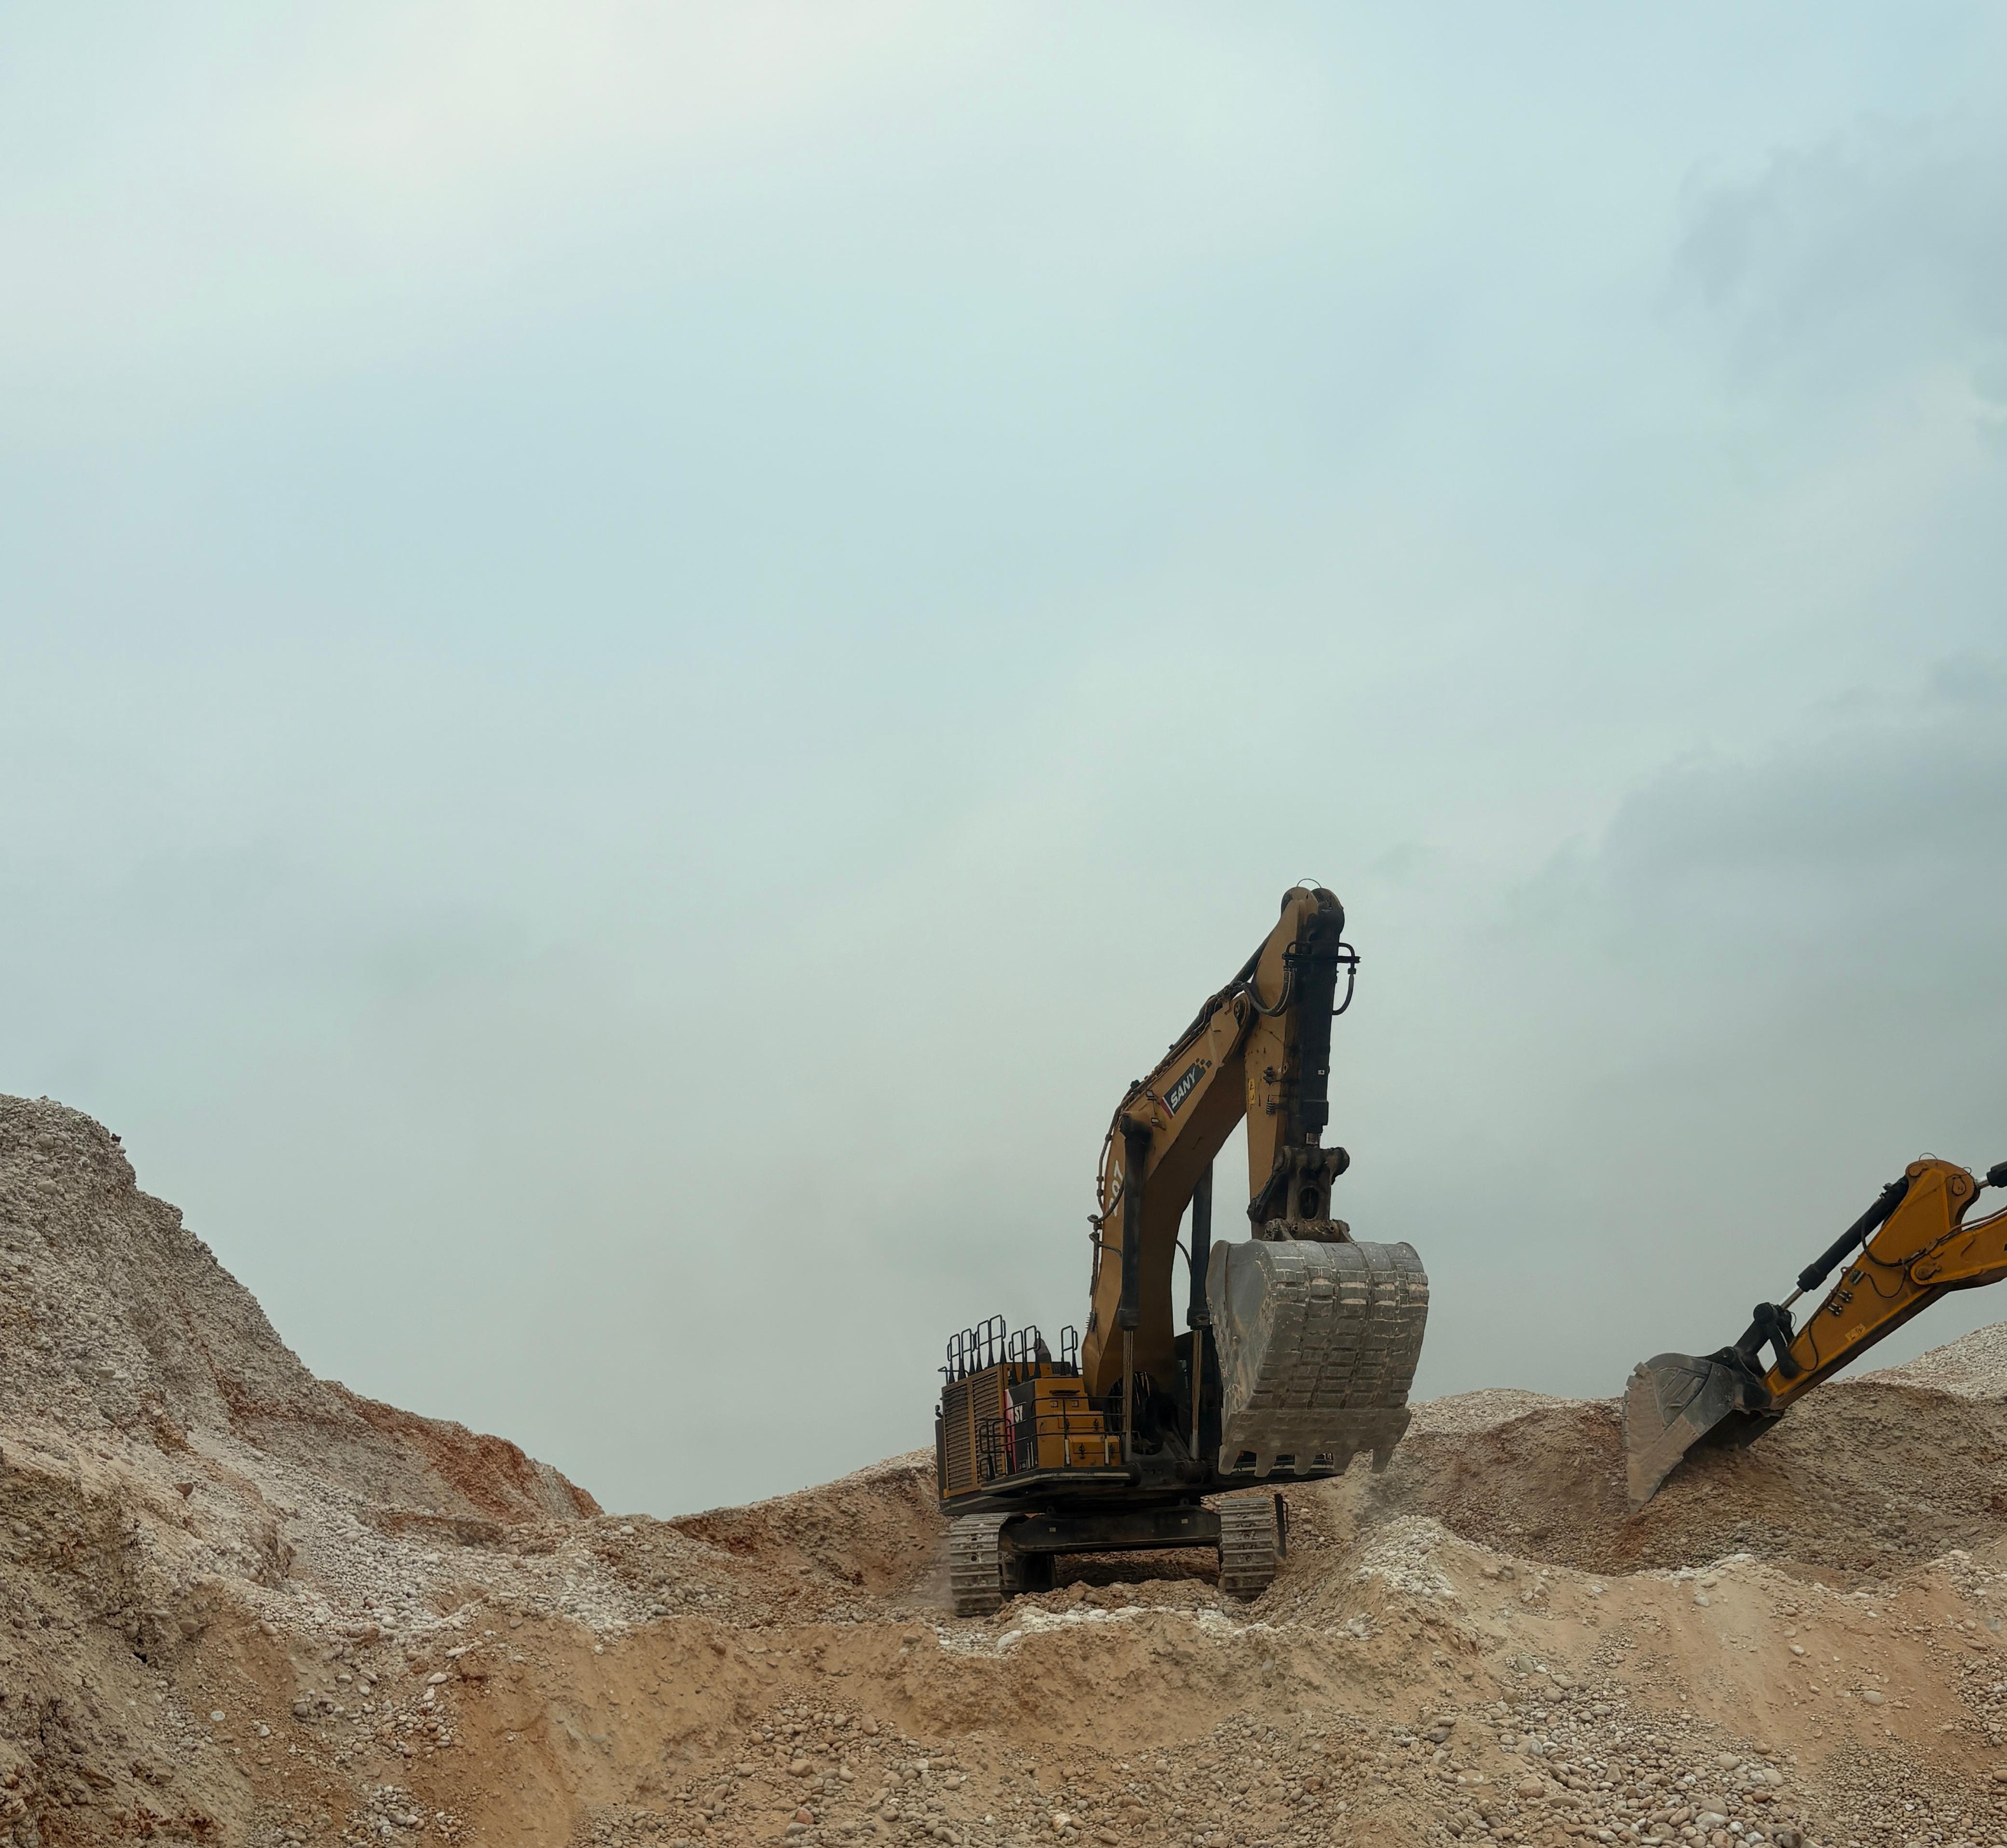
Mine Visit – Photo Gallery

Slide 18
Thank You
Questions & Discussion
Enhancing Fleet Monitoring System (FMS)
Through Data-Driven Operational Analysis
Sushant Rathore
Mining Engineering
Indian Institute of Technology (ISM), Dhanbad
Summer Internship — Adani Natural Resources

